Slide 1
BUILDING THE GROUND FOR AI IN THE FIELD OF ANTIMICROBIAL RESISTANCES
GLOBAL HEALTH SYMPOSIUM ON ARTIFICIAL INTELLIGENCE – UMCG – 11th JANUARY 2019

Slide 2


CHRISTIAN LUZ
Background:
- Medicine at RWTH Aachen University, Aachen, Germany
- MSc in Global Health at Karolinska Institutet, Stockholm, Sweden
- PhD Candidate at the Department of Medical Microbiology & Infection Prevention at the Universtiy Medical Center Groningen

Slide 3
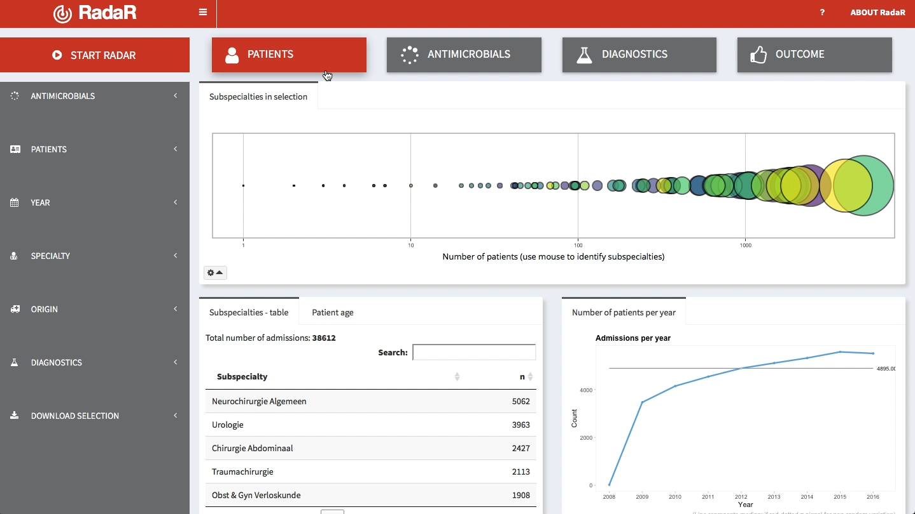

101010101010101010
010101010101010101
101010101010101010
010101010101010101
101010101010101010
010101010101010101
101010101010101010
010101010101010101
101010101010101010
010101010101010101
101010101010101010
010101010101010101

Slide 4
ANTIMICROBIAL RESISTANCES (AMR)

Slide 5
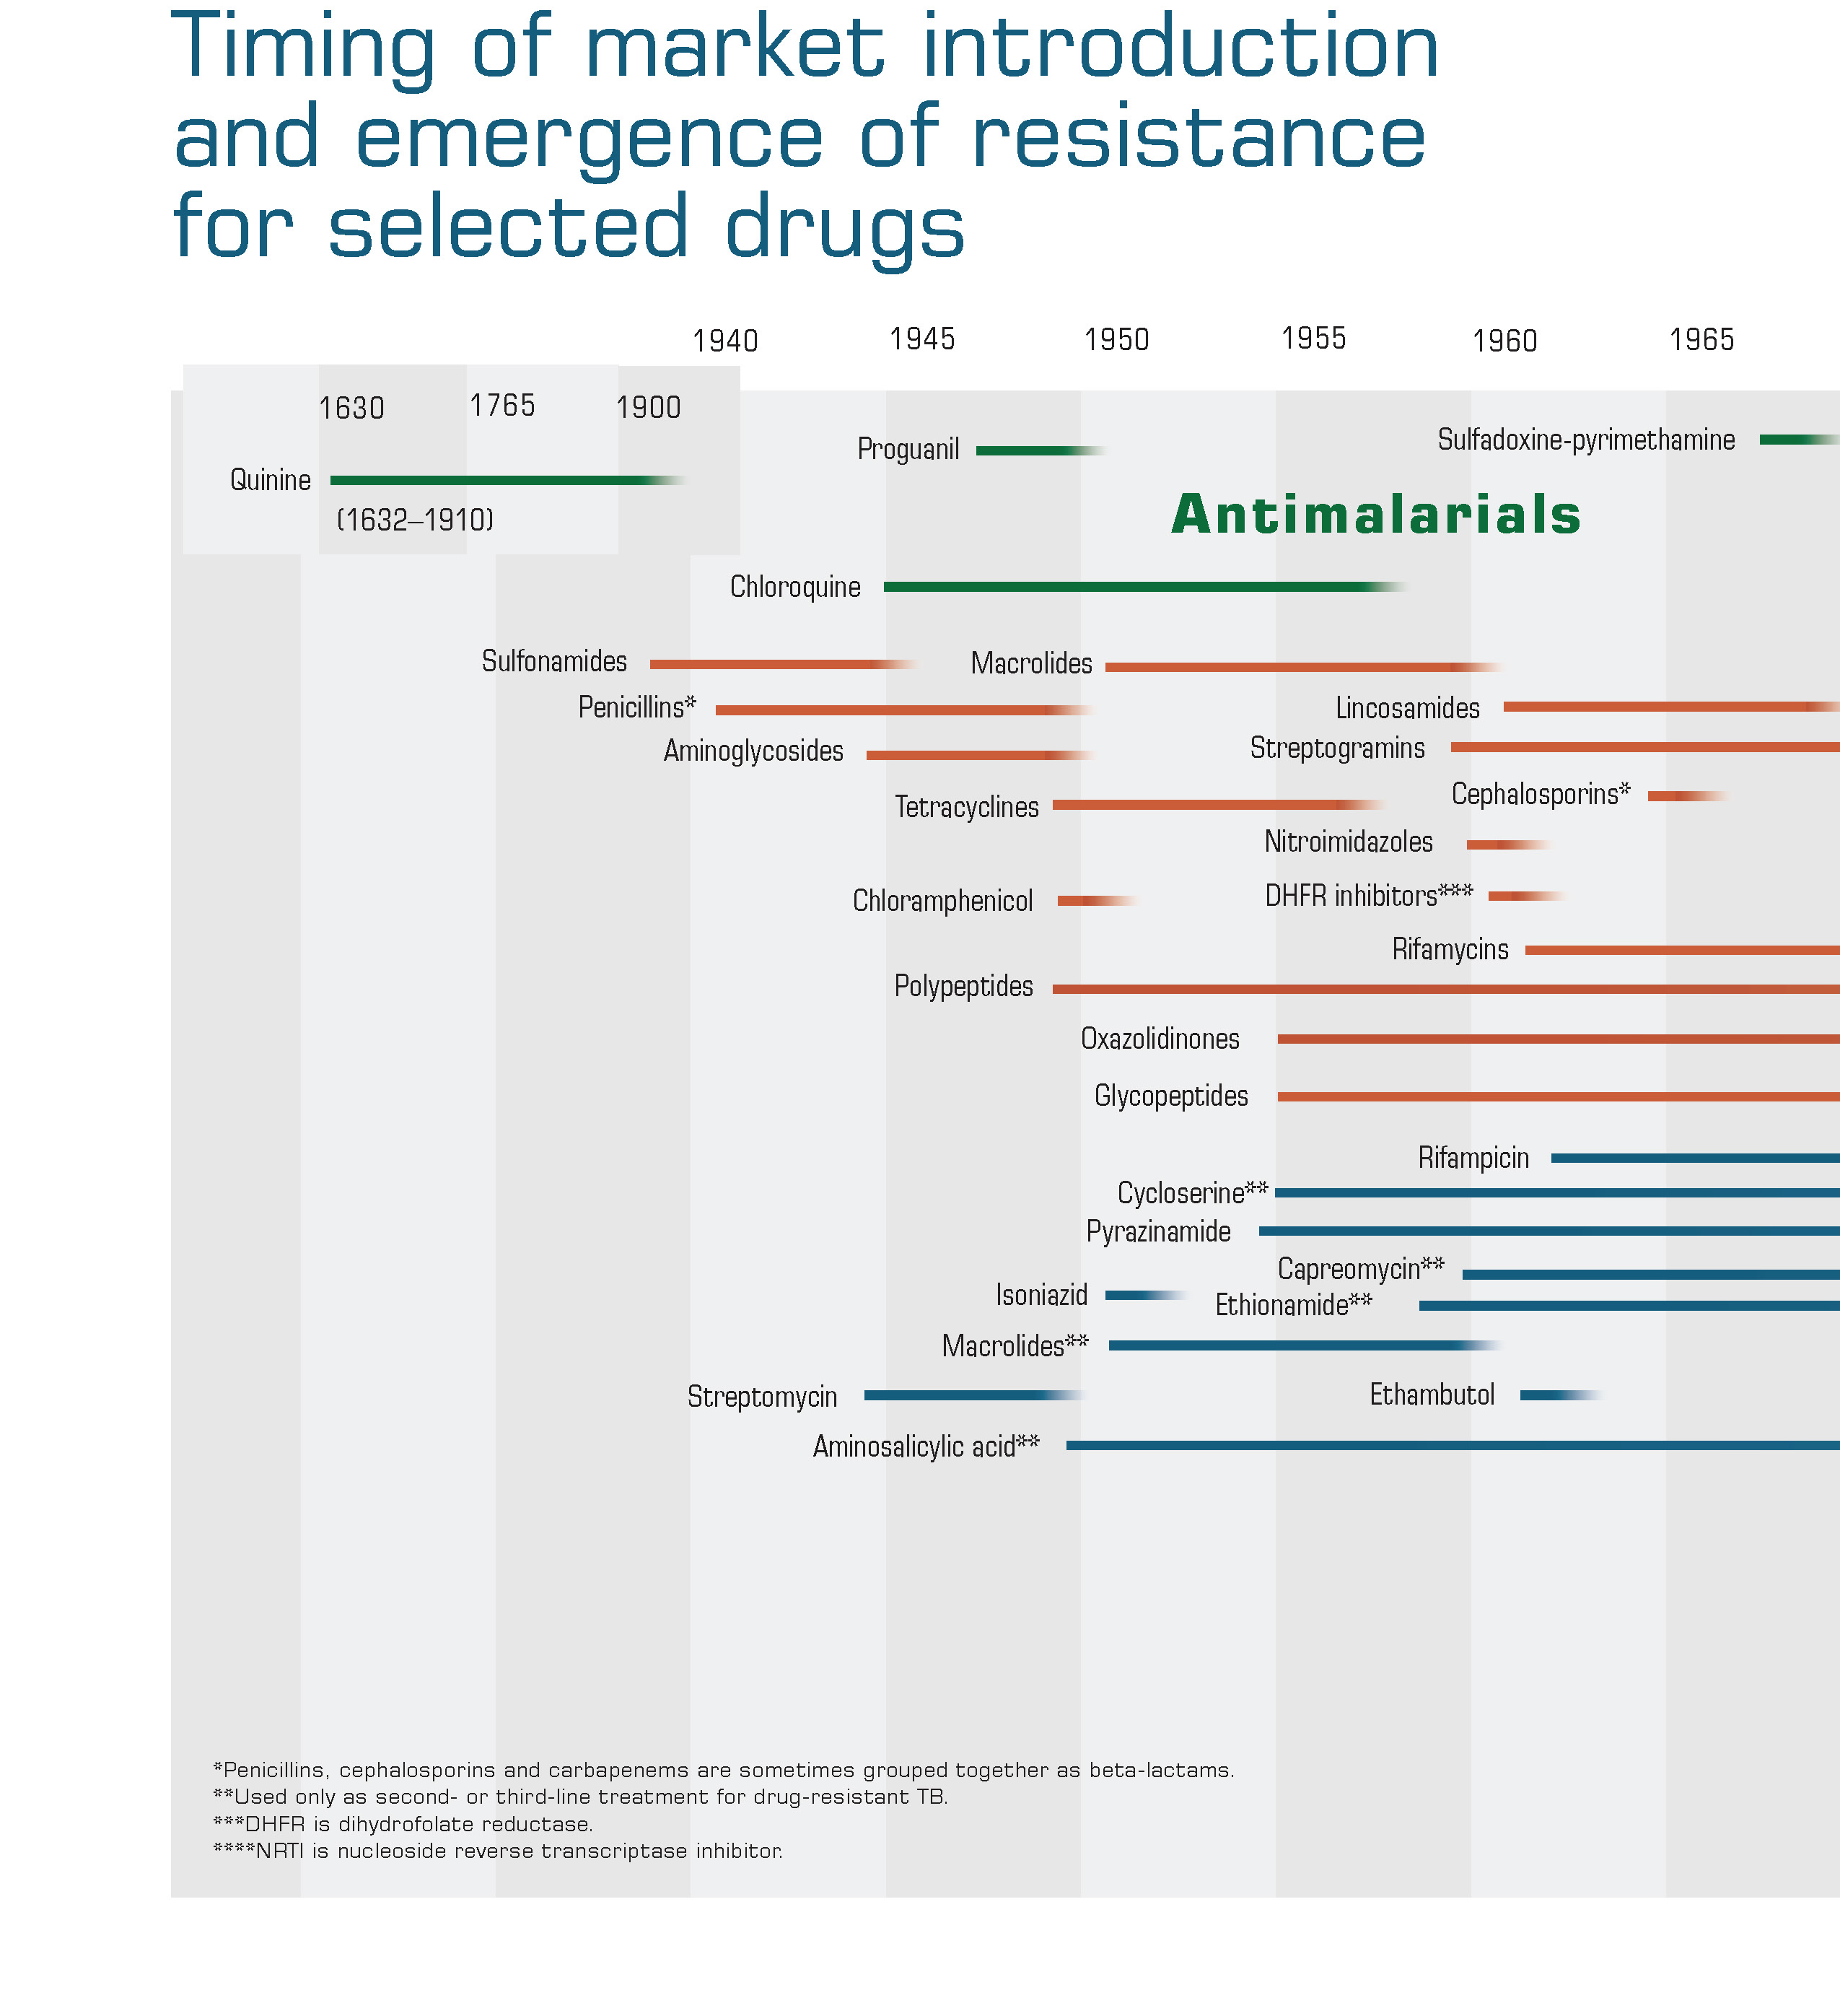
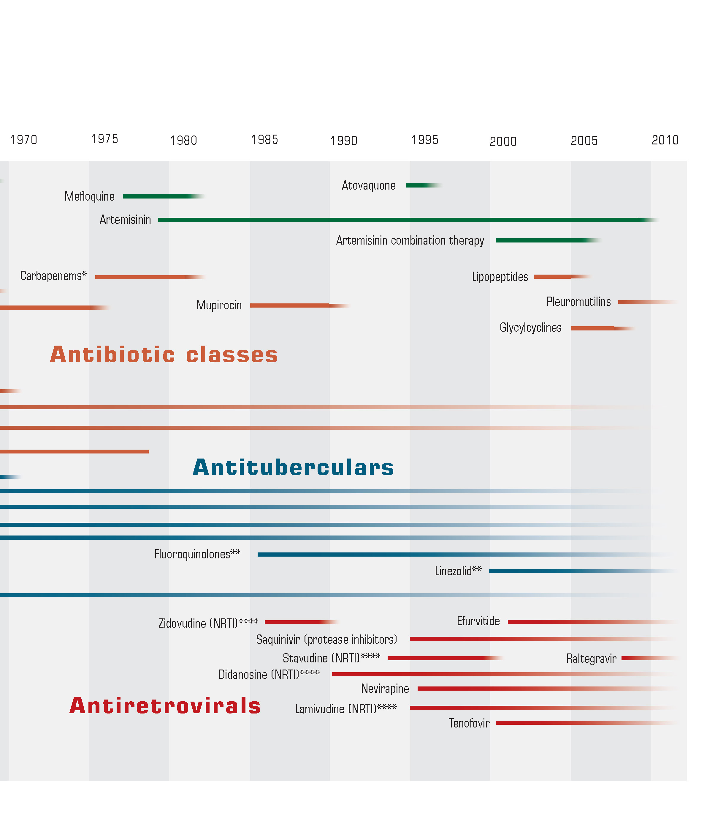
Nuget R, Back E, Beith A. The Race Against Drug Resistance. Center For Global Development. 2010

Slide 6
go to menti.com

Slide 7
OECD (2018), Stemming the Superbug Tide: Just A Few Dollars More, OECD Publishing, Paris.

Slide 8
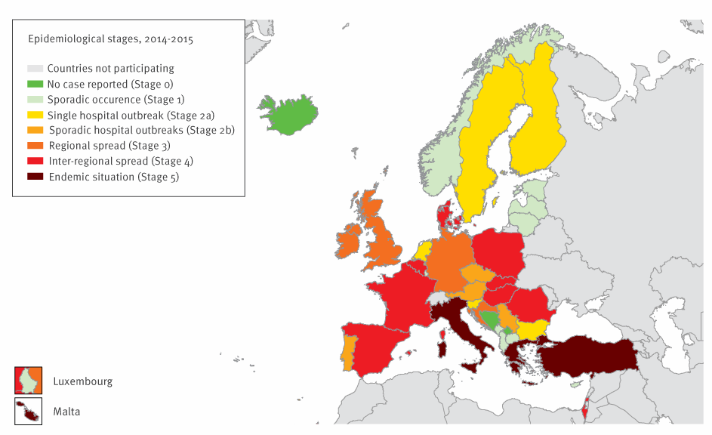
Occurrence of carbapenemase-producing Enterobacteriaceae
based on self-assessment by national experts, 38 European countries, May 2015
Albiger Barbara, Glasner Corinna, Struelens Marc J., Grundmann Hajo, Monnet Dominique L., the European Survey of Carbapenemase-Producing Enterobacteriaceae (EuSCAPE) working group. Carbapenemase-producing Enterobacteriaceae in Europe: assessment by national experts from 38 countries, May 2015. Euro Surveill. 2015;20(45):pii=30062. https://doi.org/10.2807/1560-7917.ES.2015.20.45.30062

Slide 9
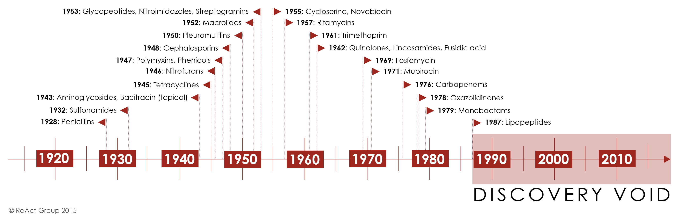

Slide 10
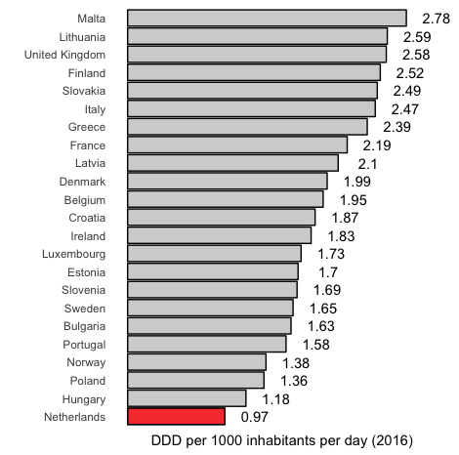
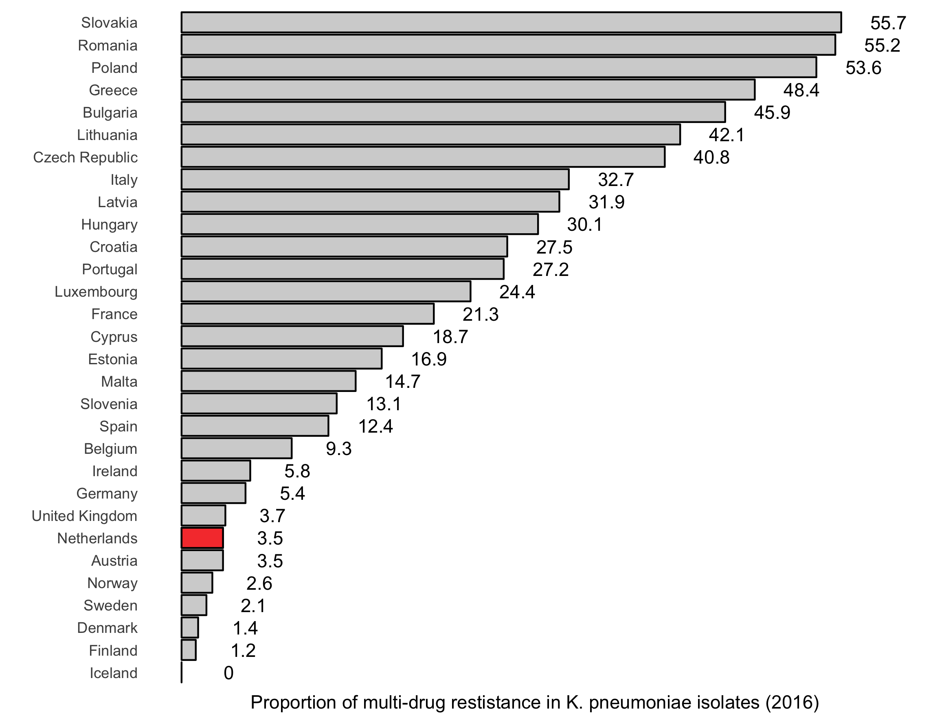

Slide 11
go to menti.com

Slide 12
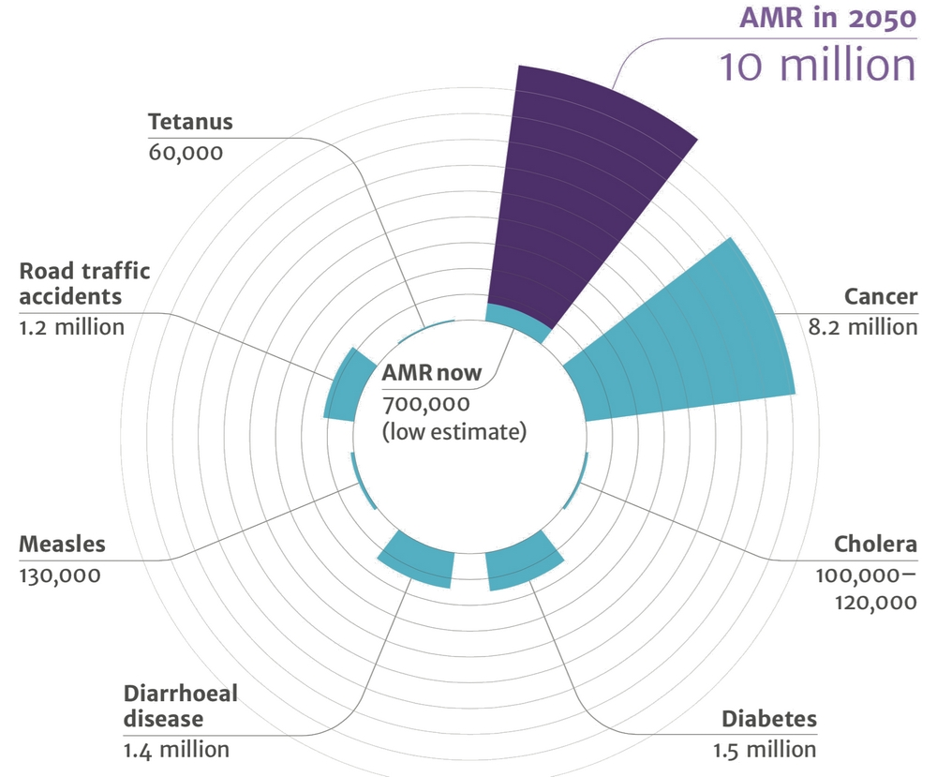
DEATHS ATTRIBUTABLE TO AMR EVERY YEAR
O’Neill J.
Antimicrobial resistance: tackling a crisis for the health and wealth of nations.
The Review on Antimicrobial Resistance. 2014;20.

Slide 13


Slide 14
AI / MACHINE LEARNING / AMR
How could AI help to tackle the global AMR crisis?
What would be needed to use AI to fight AMR?
How do we manage all that data?

Slide 15
REVIEW: AI/ML in hospitals for infection management

Slide 16
CONCLUSION

Slide 17
OPEN SCIENCE
Transparency
Reproducibility
Speed
Adaptability
CODE
CODE
CODE
CODE

Slide 18

“You can‘t do data science in a GUI.“
Hadley Wickham

Slide 19

A programming language and free software
environment for statistical computing and graphics
by the R Foundation for Statistical Computing.
Lowndes JSS, Best BD, Scarborough C, Afflerbach JC, Frazier MR, O’Hara CC, et al. Our path to better science in less time using open data science tools.
Nat Ecol Evol. 2017 May 23;1(6):160.

Slide 20
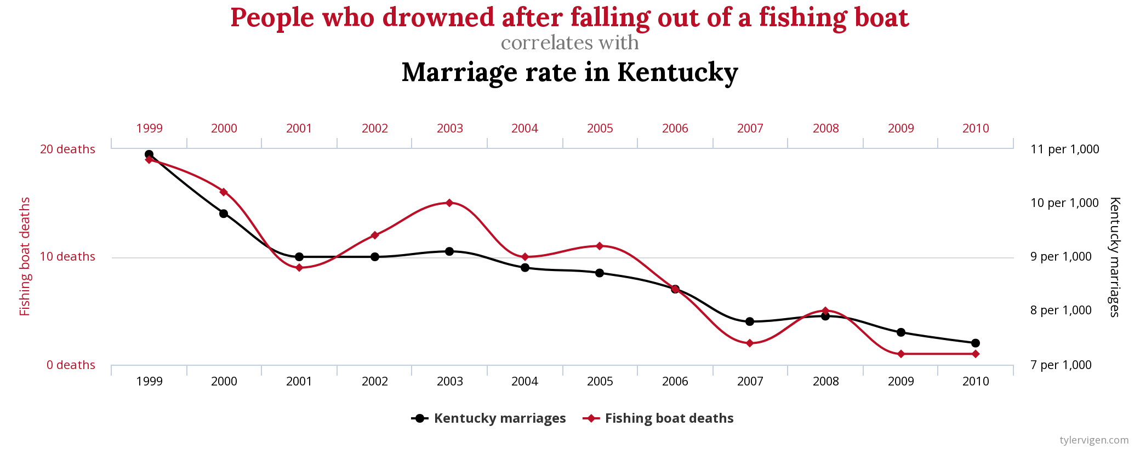

Slide 21







Links:
Learning R the fun way: https://www.datacamp.com
Hans Rosling must watch: https://www.ted.com/talks/hans_rosling_shows_the_best_stats_you_ve_ever_seen?referrer=playlist-the_best_hans_rosling_talks_yo
AMR Info:
https://amr-review.org/sites/default/files/160525_Final%20paper_with%20cover.pdf
http://www.oecd.org/health/stemming-the-superbug-tide-9789264307599-en.htm
https://www.reactgroup.org/
Machine learning and health care: https://doi.org/10.1093/cid/cix731
AI in general: https://doi.org/10.1016/j.bushor.2018.08.004
Open source in global health: http://dx.doi.org/10.1089/hs.2015.0035
Christian Luz
c.f.luz@umcg.nl
@ceefluz

